Slide 1
Samsung Innovation Campus

Slide 2

Deep Fake Image Detection
Group 2: AI Space
Nadeen Tarek, Rodha Al Marzooqi, Rukhiya Nafeesa, Aysha Asif, Pooja Meledath, Ahmad Saad

Slide 3
Deep Fake Image Detection
UNIT 1. Introduction
1.1. Problem
1.2. Solution
UNIT 2. Dataset and Data Preprocessing
UNIT 3. Data Preprocessing
UNIT 4. Models used & Results
3.1. VGG
3.2. ResNet50
3.3. DenseNet
3.4. Inception
3.5. Customized CNN (MesoNet)
UNIT 5. Conclusion & Future work
Deep Fake Image Detection
Notes:
Note:

Slide 4
Introduction
Problem
Deepfake techniques can be used to construct fake videos or images of any targeted person doing or saying anything.
These deepfaked material can be used in blackmailing, threatening and intimidating people
Deep learning models such as autoencoders and GANs are commonly used over traditional computer graphics approaches in deep fakes creation as it can rapidly generate more accurate images which are non-differentiable from real ones by the human eye.
Solution
Building a deep learning model to accurately detect AI generated images and deep fakes
The model should be able to analyze images and identify the subtle signs of manipulation to efficiently detect of deepfake compared to traditional human-based methods.
Helps in preventing malicious use of deepfakes and ensure that visual media can be trusted.
Deep Fake Image Detection
Notes:
Problem
Deepfake algorithms can construct a video of the target person doing or saying things the source person says, these are made via techniques that can overlay facial images of a target person onto a video of a source person.Faceswap is a type of deepfake that includes this.
While some deepfakes can be created by traditional visual effects or computer-graphics approaches, the recent common underlying mechanism for deepfake creation is deep learning models such as autoencoders and generative adversarial networks (GANs)
Deepfakes inflict psychological harm on the victim,reduce employability, and affect relationships.
This technique has also been used to threaten and intimidate journalists, politicians, and other semi-public figures
Solution
Solve the problem of accurately detecting deepfakes in images using machine learning algorithms.
By using AI and machine learning algorithms, the project can analyze images and identify the subtle signs of manipulation.
The project could help prevent the malicious use of deepfakes and ensure that visual media can be trusted.
The project could potentially help improve the accuracy and efficiency of deepfake detection compared to traditional human-based methods.

Slide 5
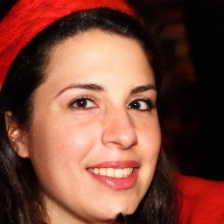

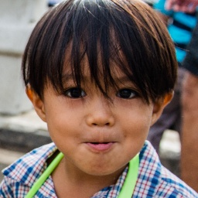
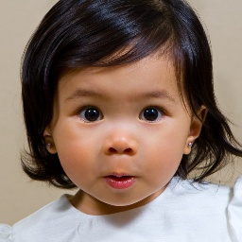
140k Real and Fake Faces Dataset
This dataset from Kaggle consists of 70k REAL faces from the Flickr dataset and 70k fake faces generated by StyleGAN
The data is divided into train, test, valid directory, each of them have a fake and real subdirectory.
Train,Valid,Test consists of 100k,20k,20k images respectively.
Each image has a shape of (256,256,3).
Fake
Real
Deep Fake Image Detection
Notes:
This dataset consists of all 70k REAL faces from the Flickr dataset collected by Nvidia, as well as 70k fake faces sampled from the 1 Million FAKE faces (generated by StyleGAN).
The dataset was obtained from kaggle. The data was not available in its desired tabular format but rather in the form of a directory structure.The train,test, valid directory, each of them have a fake and real subdirectory.
The train, test and valid contain a balanced sample of real and fake images.
Train,Valid,Test consists of 100k,20k,20k images respectively.
Each image has a shape of (256,256,3).
The images have been compressed to (64,64,3) to facilitate faster processing

Slide 6
Data Preprocessing
1
2
3
4
Import dataset from Kaggle to the coding environment using Kaggle API
Normalize all the training, validation and testing images sets
Resize all the images to smaller sizes (64*64) to ensure faster training
Perform data augmentation on the training set by rotating, zooming, and flipping the existing images
Deep Fake Image Detection

Slide 7
Models used
VGG
ResNet50
DenseNet121
Inception
Customized CNN (MesoNet)
Deep Fake Image Detection

Slide 8
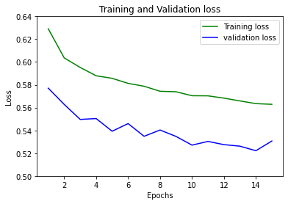
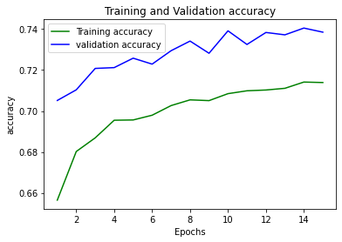
VGGNet
Feature Extraction: using VGG16 transfer learning
Classification : DenseLayer+ BatchNormalization + DenseLayer +DropoutLayer+Dense output layer (sigmoid activation)
Precision |  | Recall |  | F1-score |  | Accuracy
Real | Fake | Real | Fake | Real | Fake
0.7389 | 0.734 | 0.7319 | 0.7417 | 0.7354 | 0.7378 | 0.74
Deep Fake Image Detection
Notes:
Early stopping after 13th epoch.
A high recall score indicates that the model is good at identifying positive examples.

Slide 9
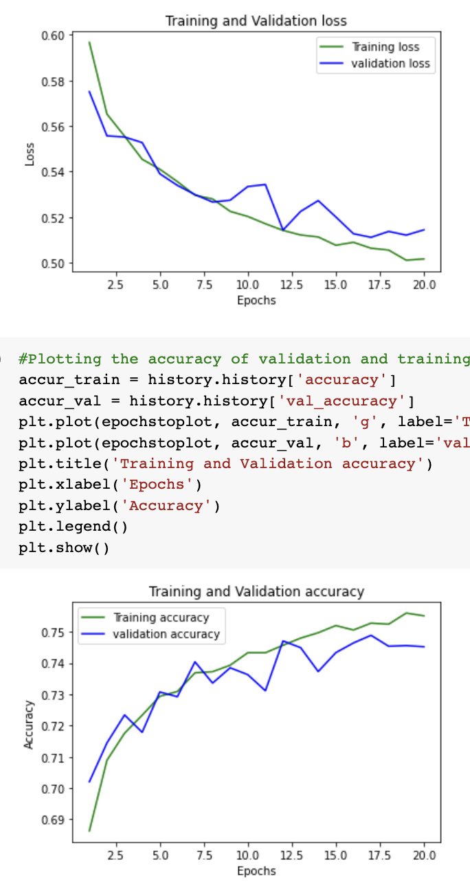
ResNet50
Feature Extraction: Pre trained ResNet50
Classification: 3 Dense layers (output layer with Sigmoid Function)
Precision |  | Recall |  | F1-score |  | Accuracy
Real | Fake | Real | Fake | Real | Fake
0.7844 | 0.7315 | 0.704 | 0.8065 | 0.7420 | 0.7672 | 0.75525
Deep Fake Image Detection

Slide 10
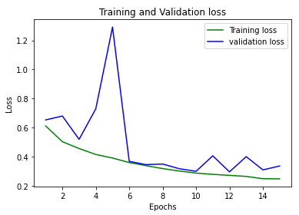
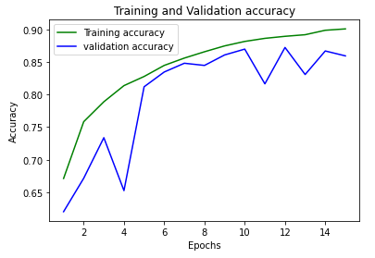
DenseNet121
Feature Extraction: Pre trained DenseNet121
Classification: 2 Dense layers (Final layer with Sigmoid Function)
Precision |  | Recall |  | F1-Score |  | Accuracy
Real | Fake | Real | Fake | Real | Fake
0.85 | 0.93 | 0.93 | 0.84 | 0.89 | 0.88 | 0.89
Deep Fake Image Detection

Slide 11
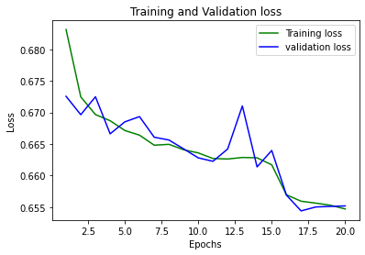
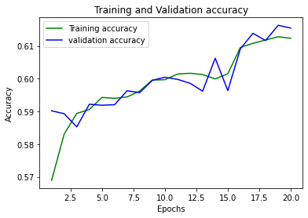
Inception
Feature Extraction: Pre trained InceptionV3
Classification: 2 Dense layers (Final layer with Sigmoid Function)
Precision |  | Recall |  | F1-Score |  | Accuracy
Real | Fake | Real | Fake | Real | Fake
0.61 | 0.64 | 0.69 | 0.56 | 0.65 | 0.60 | 0.63
Deep Fake Image Detection

Slide 12
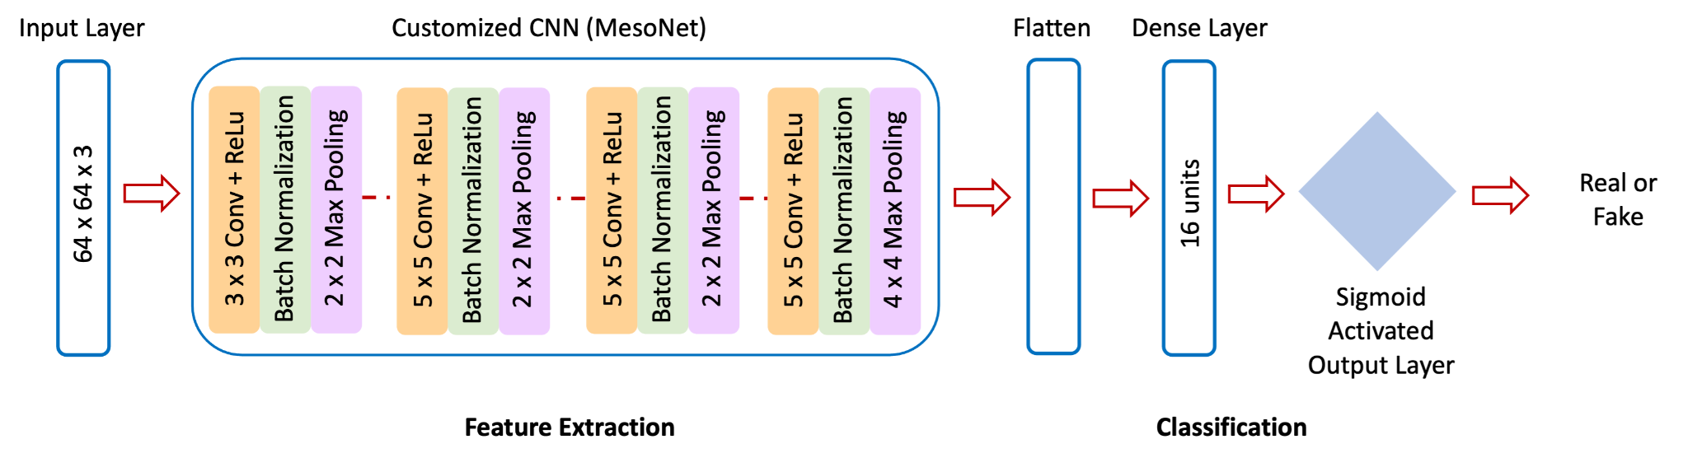
Customized CNN (MesoNet)
Precision |  | Recall |  | F1-Score |  | Accuracy
Real | Fake | Real | Fake | Real | Fake
73.97% | 83.30% | 86.03% | 69.73% | 79.54% | 75.91% | 77.88%
Deep Fake Image Detection
Notes:
Before the dense layer and before the sigmoid output layer, there is a 0.5 rate dropout layer

Slide 13
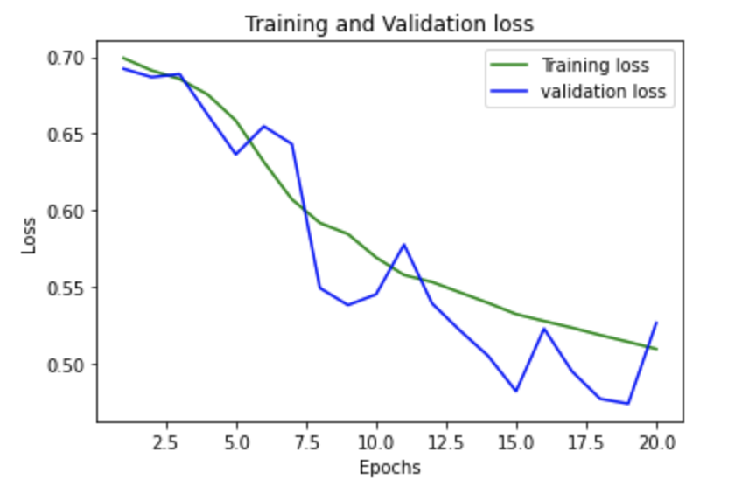
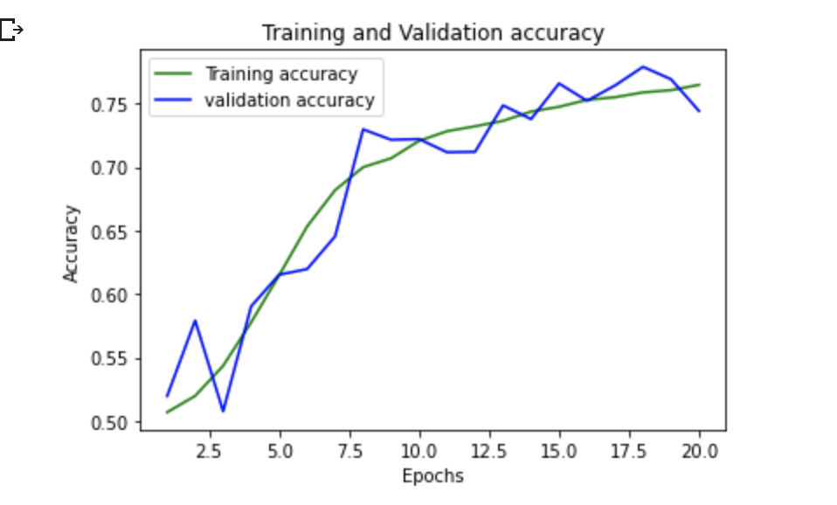
Customized CNN (MesoNet)
Deep Fake Image Detection

Slide 14
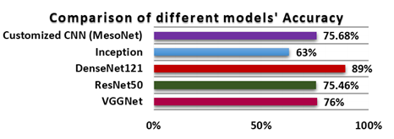
Conclusion
Summary
We tried 5 models some were
pre-trained models and some
were trained from scratch
Among the 5 different models we trained,
DenseNet121 had the highest accuracy of
89% for detecting real and fake images.
The DenseNet validation and training accuracy reflects that the model is not overfitting
Future Work
Enhance our model's performance to detect Deepfake images and videos as well.
A web application may be developed to make it easier for the cybersecurity professionals to detect DeepFake image/video fraud and prevent deepfake-based cybercrimes.
77.88%
74%
Deep Fake Image Detection

Slide 15
Thank you

